Slide 1
CISC108
[Instructor Name]
University of Delaware
Introduction to Computer Science
Week 7 - Debugging

Slide 2
Reminders

Slide 3
Poll Everywhere Review Questions!

Slide 4
Most programs are very long.
So far, our programs have been very short.
They will soon get longer!
Notes:
We’re going to talk to them a little bit about how big programs are. They probably don’t have much sense of scope at this point.

Slide 5
Orders of Magnitude
SLOC: “Source Lines of Code”
KLOC: 1,000 lines of code
MLOC: 1,000,000 lines of code
GLOC: 1,000,000,000 lines of code
...
You are here!
Notes:
There’s some terminology here, but I don’t think it’s worth getting bogged down with it. The idea is to just highlight that we definitely measure code in huge quantities.

Slide 6
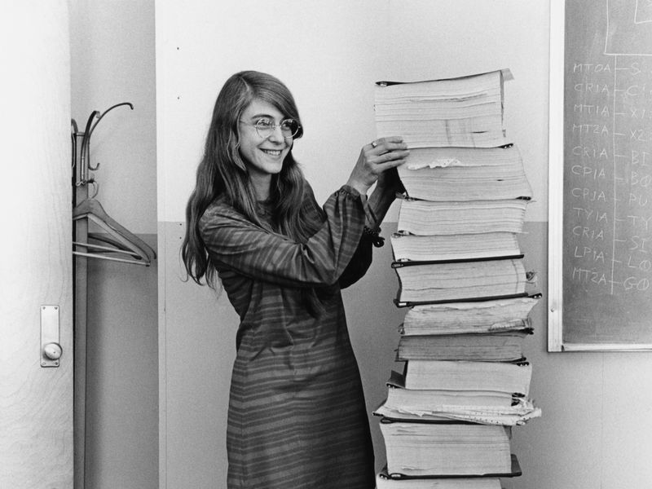
This famous photo depicts Margaret Hamilton, leader of the software engineering team for the Apollo Project, next to a print out of the code she and her team wrote for the mission. Taken in 1969.
Notes:
And here’s some fun history! Read up on her: https://en.wikipedia.org/wiki/Margaret_Hamilton_(software_engineer)
You can mention that we don’t often print out programs any more, but back then they had to, since there weren’t terminals (at least as we know them now).

Slide 7
Examples of Number of Lines of Code
This web page
Unix v1.0 (1971)
S
K
Chrome
Google
M
G
~300 lines of code on this page (a lot of other code is imported in)
~5000 lines of code in version 1 of the popular OS
~25 million lines of code in 2020
>2 billion lines of code in their internet services in 2015
Notes:
Here are some random examples of programs of different size. Some of it was hard to track down, and may vary over time.
This page is in HTML/JS/CSS, and it’s minified, so talking about its size is a little silly, but still is a valid example.
They might not know Unix? Tell them it’s the thing that Linux and Mac evolved into, they should know one of those at least.

Slide 8
“Lines of Code” is not a great metric
Less is More
Smarter Code
Exaggerations
Better to remove code that is unnecessary.
(e.g., -2000)
For loops can be replaced by writing MANY statements over and over again!
A lot of code is generated by computers (based on templates or similar projects)
Notes:
But don’t let them walk away thinking the number of lines of code is anything more than a starting point (we will talk about time complexity later).
The story below is a good one for why we ACTUALLY love to remove lines of code (“Less is More”).
We often can write “Smarter Code” that takes up less space while achieving the same goal, heck that’s the point of FOR loops!
And of course, a lot of systems automatically generate code nowadays, so that pads the estimates.
—---------------
https://www.folklore.org/StoryView.py?story=Negative_2000_Lines_Of_Code.txt
I think it’s fun to tell some variation of this story:
“In early 1982, the Lisa software team was trying to buckle down for the big push to ship the software within the next six months. Some of the managers decided that it would be a good idea to track the progress of each individual engineer in terms of the amount of code that they wrote from week to week. They devised a form that each engineer was required to submit every Friday, which included a field for the number of lines of code that were written that week.
Bill Atkinson, the author of Quickdraw and the main user interface designer, who was by far the most important Lisa implementor, thought that lines of code was a silly measure of software productivity. He thought his goal was to write as small and fast a program as possible, and that the lines of code metric only encouraged writing sloppy, bloated, broken code.
He recently was working on optimizing Quickdraw's region calculation machinery, and had completely rewritten the region engine using a simpler, more general algorithm which, after some tweaking, made region operations almost six times faster. As a by-product, the rewrite also saved around 2,000 lines of code.
He was just putting the finishing touches on the optimization when it was time to fill out the management form for the first time. When he got to the lines of code part, he thought about it for a second, and then wrote in the number: -2000.
I'm not sure how the managers reacted to that, but I do know that after a couple more weeks, they stopped asking Bill to fill out the form, and he gladly complied.”

Slide 9
Previously:
“Decomposing large programs makes them easier to debug”
Is that really true?
Notes:
Okay, so last week we made the claim that we needed to learn how to decompose programs because it would make them easier to debug, and that this was critical for longer programs.
They hopefully believe that their programs will get longer, now we need to convince them that decomposing those programs is necessary.

Slide 10
Software Bugs are Dangerous
2014: All 911 services in the state of Washington go down for 6 hours because of an arithmetic error in the code
2007: Toyota loses a lawsuit because of expert testimony that their poorly written “spaghetti code” caused brakes to fail and more than 9 million cars had to be pulled.
1962: Unmanned spacecraft Mariner 1 had an aborted launch (costing $80 million) because of a missing hyphen.
Notes:
Some reminders that bugs be very serious business.
https://priceonomics.com/the-typo-that-destroyed-a-space-shuttle/

Slide 11
Why does decomposition help?
Testing
Thinking
Easier to test a smaller function than a longer function
Easier to reason about a smaller function than a longer function

Slide 12
Unit Tests!
Write Tests
Keep Tests
One of your best tools for debugging a program.
BEFORE you write the body!
Add new tests, don’t replace tests.

Slide 13

Thonny’s Debugger
Powerful tool for stepping through code.
Predict the next step of your code before you use the button!
Notes:
Remind them that the debugger is another tool in their arsenal for trying out code!

Slide 14
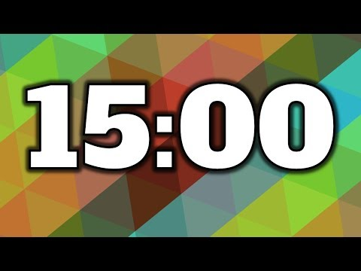
Lecture 7 - Sequences
Let’s test if debugging is easier with decomposed functions!
Need to find all 8 bugs in the two programs that solve gardening problem!
Going to work in groups of 2
Everyone must make their own submission
Collaborate and discuss ideas
Read all the instructions before starting.
We will review the answers here in class in about 15 minutes.
Start working!

Slide 15
Reviewing Answers
Open up the question list and review the questions with students. Type up a class answer.

Slide 16
CISC108
Have a great day!
Don’t forget:
See ya!

